Slide 1
Automobile Market Analysis
Student : Priya Kumari Mishra
Mentor : Jaya Pandey

Slide 2

Analysis of competitive automotive Industry producing diverse car manufacturers to identify the topmost demanding model and manufacturer should be launched in feature to spike the sales and generate maximum revenue.

Slide 3

Top Models and Manufactures
Analyze Automobile Industry producing Diverse range of cars.
Highlight the Top Manufacturers producing cars with top performance.
Interpret the Upcoming cars to be lunched as per current market demand to generate maximum sales.

Slide 4




Automobile Market Analysis - 1
1. Top 10 Cars and manufacturers with highest Milage.
2. Top 10 Car and manufacturers producing highest milage based on displacement.
Interpretation:
Mahindra’s E20 Plus is producing highest Milage that is 80. But can’t rely on this as this milage may be exceptional.
The average highest mileage produced by top cars is between 28 to 23. Suzuki Dezire standout to highest mileage producing cars.
Interpretation:
BMW’s X series gives highest Displacement with maximum Milage. But few cars producing high displacement don’t standout for high milage too.

Slide 5
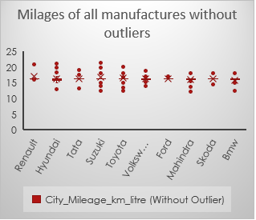
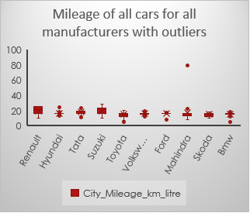
Automobile Market Analysis - 1
3. Top 3 Cars and manufacturers with maximum no. of Hatchback Body Type.
4. Compare the mileage of the cars produced by all manufacturers and perform outlier analysis.
Interpretation:
Suzuki, Hyundai and Tata produces maximum no. of Hatchback cars and, Suzuki stands out highest Hatchback Making cars. So, If Consumer is more interested in Hatchback and should go for Suzuki for variety of series in Hatchback models.
Interpretation:
The starting range of the mileages has been increased by removing and imputing outlier mileage for the cars. Most of the cars gives mileage between 15 to 28.

Slide 6
Automobile Market Analysis - 1
5. Relationship between Displacement and Milage & Milage and Fuel Tanks Capacity.
6. Best Car for adventure Drives.
Make (Manufacturer) | Model (Car name) | Power (CC) | Size of the Car (Meter^3) | Ground_Clearance (in mm) | Number_of_Airbags | Child_Safety_Locks
Toyota | Land Cruiser | 35688 | 18.72 | 225 | 8 | Yes
Interpretation:
1. For Adventure Drives the deciding factors for adventure can be different for all consumers but considering all importance factors should be above average and picked up top performers among them should be good decision. Also, Considering Safety as important filtered only for Safe cars with child safety.
2. Considering Drive is adventuring Toyota Land Cruiser stand out to be best to choose by more focusing on safety feature, ground clearance for better ride, Size for More people and high Power.
Interpretation:
There is very weak negative Correlation in the Displacement and Milage of the cars. So, the cars providing maximum displacement provided slightly less milage. But both are interdependent criteria for consumer to choose on these 2 factors.
Similar, very weak negative correlation in Milage and fuel tank capacity, So car having maximum milage slightly have lesser fuel tank capacity. But factors are not dependent for make decision.

Slide 7
Automobile Market Analysis - 1
7. To Choose Family Cars: On basis of Size, milage, safety, comfort, entertainment.
Interpretation:
1. Considering Suitable car for Family on features : Car size, safety, Milage, seating capacity, entertainment system. Renault Lodgy fits most suitable car fulfilling all the decision-making criteria.
2. For More people to be adjust Mahindra Tuv300 Plus can also be a choice with slight compromise on Milage.

Slide 8
Automobile Market Analysis - 1
8. Potential Competitive cars for Compact and Family cars
Interpretation:
1. Consumer for Compact City car primarily looks for Ideal Length (4.3 to 4.8 meter) having Maximum Milage along with safety features.
2. Potential Competitor Compact City Cars in the market are Suzuki-Ciaz, S-Cross, Renault-Lodgy, Mahindra-TUV3000PLUS, BMW-X1.
3. Suzuki-ciaz standout to be the best suitable Compact city cars.
1. Consumer for Family car primarily looks for Comfortable and safe drives and pocket friendly as well.
2. Potential Competitor Compact City Cars in the market are BMW-X1, Mahindra-TUV3000PLUS, Mahindra-TUV3000, Suzuki-Ciaz, S-Cross, Renault-Lodgy,,
3. BMW-X1 standout to be the best suitable Family cars with high safety, max bot space, good mileage, entertainment, and good enough size suitable for family drives.

Slide 9
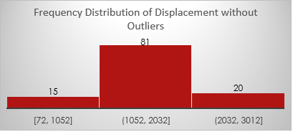
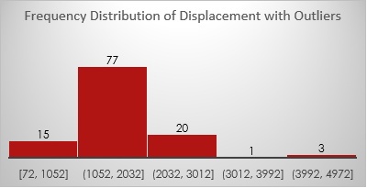
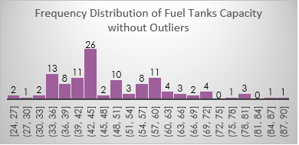
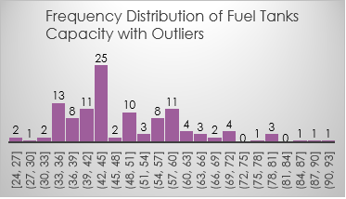
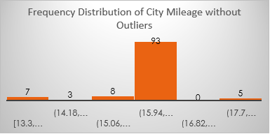
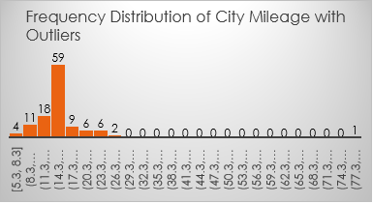
Analysis of Top cars to be launched -
9. Identify outlier using histogram for 1. Displacement 2. City mileage 3. Fuel Tank Capacity.
Interpretation:
1. Displacement : The ideal range is from 70 to 3000, observed after imputing outlier displacements. Only few cars (20) exists in market which produce maximum displacement.
2. City mileage : The average maximum cars have mileage between 15 to 17. The maximum possible mileages has been seen to be 22-28 after imputing outliers. Also mileage range has been refined in a defined range (13 to 20) after removing outliers.
3. Only 1 outlier existed in Fuel tanks capacity. The ideal range observed is 20 to 100.

Slide 10
Automobile Market Analysis - 1
10. Identify top 3 Car manufacturers with highest no. of variants in 1. Hatchback, 2. Sedan, 3. SUV
Interpretation:
Top 3 car manufacturers producing highest no. of variants in Hatchback are – Suzuki, Hyundai and Tata.
Top 3 car manufacturers producing highest no. of variants in Sedan are – Hyundai, Skoda and Toyota.
Top 3 car manufacturers producing highest no. of variants in SUV are – Mahindra, Hyundai and Tata.

Slide 11
Automobile Market Analysis - 1
11. Most Popular body type by count, from Analysis 2 : Top cars giving highest mileage on basis of displacement.
Interpretation:
Most popular cars body type producing highest ,mileage with highest displacement are – SUV and Sedan. SUV cars.

Slide 12
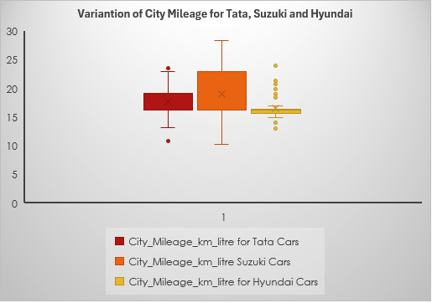
Automobile Market Analysis - 2
1. Top 2 manufacturers who offers the widest range of car variants.
2. Calculate and compare variations between city mileage data using different measures of dispersions for 1. Tata 2. Suzuki 3. Hyundai.
Interpretation:
1. Suzuki and Hyundai offers widest range of car variants.
2. Suzuki makes 163 Variants, which is the widest range of variants, and maximum in Hatchback body types
Interpretation:
1. Maruti Suzuki offers the widest variation in city Mileage.
2. Maruti Suzuki offers highest city mileage from Tata and Hyundai.
3. Hyundai provides the least range of city mileage.

Slide 13
Automobile Market Analysis - 2
3. Correlation between City Mileage and Fuel tank capacity & Displacement and Fuel Tank Capacity.
5. a. Visualize Fuel efficiency Comparison across all manufacturers for all fuel types.
Interpretation:
1. City Mileage and Fuel tank capacity has good negative correlation, that means higher the City mileage lower the Fuel tank capacity.
2. Displacement and Fuel tank capacity has slightly positive relation, So Cars having high displacement may also have high fuel tank capacity.
Interpretation: (to create histogram)
1. Electric cars are the most Fuel Efficient, but its availability is very less. Only Mahindra, Hyundai and Tata makes electric cars.
2. Diesel and Petrol are also high fuel-efficient cars.
3. Skoda, Tata, Hyundai, Ford, Toyota rea close competitors
.

Slide 14
Analysis of Top cars to be launched -
5.b. Correlation between Speed, Distance and Fuel efficiency.
Correlation
Fuel Efficiency Vs Avg combined mileage | 1 | Linear relation
Fuel Efficiency Vs Distance Driven | 0.337959 | weak positive relation
Fuel Efficiency Vs Speed | -0.69196 | weak negative relation
Interpretation:
1. Cars having higher mileage certainly have high fuel Efficiency.
2. More distance driven cars have slight increase in fuel efficiency.
3. Fuel efficiency are less for high-Speed drivers. So high speed drivers should look for highest mileage cars.

Slide 15
Analysis of Top cars to be launched -
5.b. Correlation between Speed, Distance and Fuel efficiency.
5.c. Identifying Opportunities for reduction emissions: Group by fuel efficiency and analyse.
Correlation
Fuel Efficiency Vs Avg combined mileage | 1 | Linear relation
Fuel Efficiency Vs Distance Driven | 0.337959 | weak positive relation
Fuel Efficiency Vs Speed | -0.69196 | weak negative relation
Interpretation:
1. Mahindra Manufactures sales most Fuel-efficient cars in fuel type Electric (E20 PLUS) and Diesel (Kuv100 Nxt)
2. Hatchback body type cars are high mileage cars and Suzuki is the highest hatchback producer.
3. Most of the cars are present in Hatchback body type and considered to be most demanding cars, so Suzuki is the biggest potential competitor car manufacturer.
4. Suzuki produce maximum cars and Mahindra, Hyundai, Tata are close competitor .
Interpretation:
1. Cars having higher mileage certainly have high fuel Efficiency.
2. More distance driven cars have slight increase in fuel efficiency.
3. Fuel efficiency are less for high-Speed drivers. So high speed drivers should look for highest mileage cars.

Slide 16
Analysis of Top cars to be launched -
6. Summarization of all analysis and summarized Interpretation for Potential Models to launch :

Slide 17
Summary
1. Mahindra Manufactures sales most Fuel-efficient cars in fuel type Electric (E20 PLUS) and Diesel (Kuv100 Nxt)
2. Suzuki makes 163 Variants, which is the widest range of variants, and maximum in Hatchback body types.
3. Most of the cars are present in Hatchback body type and considered to be most demanding cars, so Suzuki is the biggest potential competitor car manufacturer.
4. Mahindra, BMW, Hyundai, Tata are close competitor .
5. As per market demands for high fuel efficient and high mileage cars, Suzuki and Mahindra are Close competitors for market demand and supply.
6. Also, for safe cars BMW, Toyota, Mahindra, Volkswagen makes the safest cars.
7. BMW standout to best for safest, with average Fuel efficiency and mileage.
Potential Car/Models to be launched -
Suzuki - Baleno, Dzire, Ciaz, Mahindra - Kuv100 Nxt,Tuv300 Plus are best performers and eco-concious with slight with average safety.
BMW - X1 - best for Safest rides and good average mileage and performance.

Slide 18
THANK YOU

